Slide 1
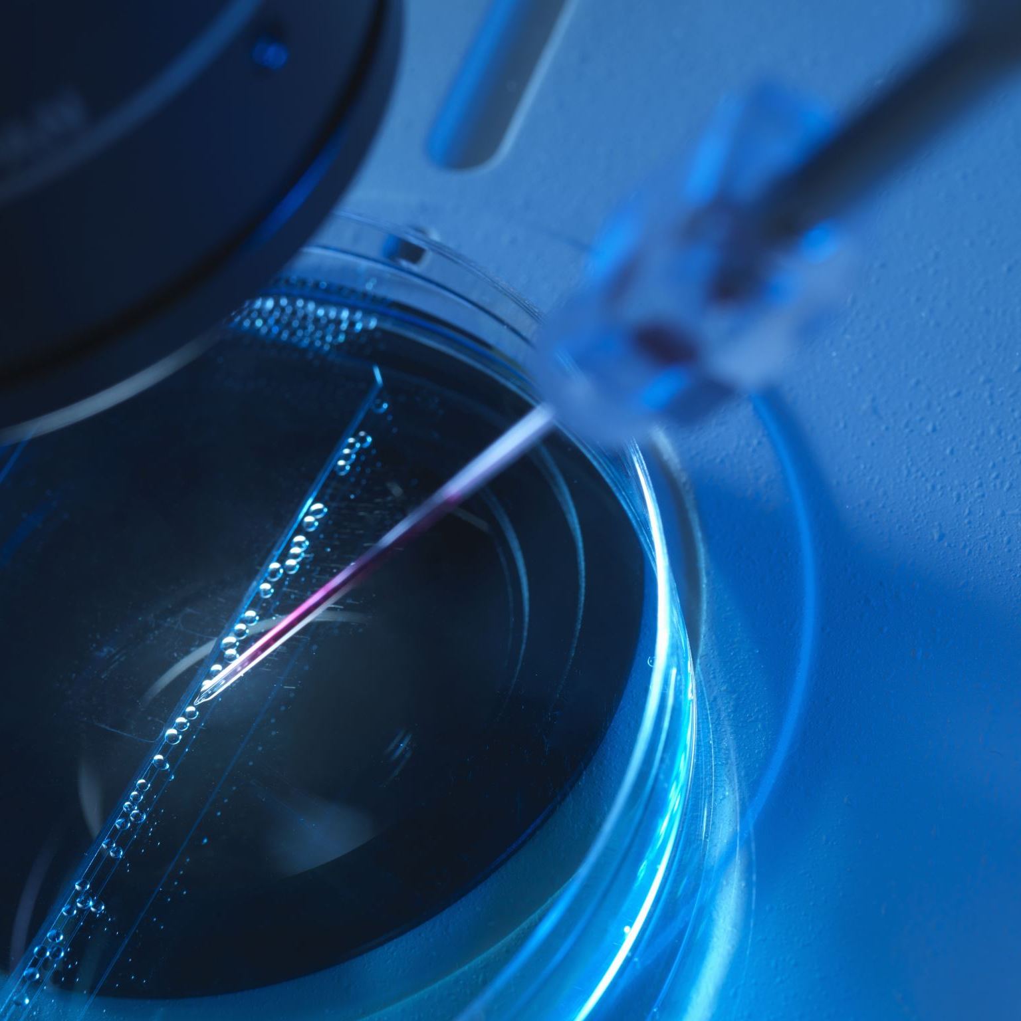
Surgical Video Analysis
AIML Project Elective Term II 2022-23
Week I Feb 14-21

Slide 2
Task Assigned
Task
Surgical Tool Localization
Dataset
m2cai-16 tool locations

Slide 3
Outcomes Expected
1) Understanding the dataset and annotations
2) Understanding Yolov7 architecture (https://arxiv.org/pdf/2207.02696.pdf)
3) Applying yolov7 object detector on m2cai16-tool-locations dataset
4) Understanding the importance of loss function.
5) Understanding yolov1 - yolov7 variants (evolution of yolo architecture)
6) GitHub repo with experiments conducted

Slide 4
Evolution of YOLO Architecture
CNN
R-CNN
Fast R-CNN
Faster R-CNN
YOLO Architectures

Slide 5
This week..
CNNs for Object Detection
Moving from CNNs to Regional-CNNs for Object Detection
Architecture of R-CNN, Fast R-CNN and Faster R-CNN
Understanding the Dataset

Slide 6
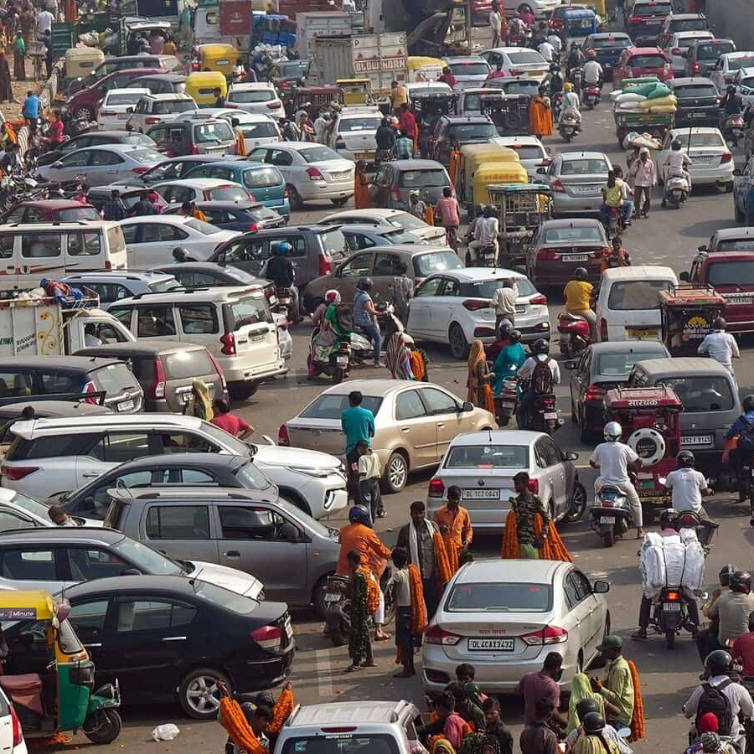
Object Detection - CNNs
Image = Multiple Objects + Multiple instances of an Object
A CNN with fully connected layer can’t deal with the object detection
Brute Force Method – Slicing the image
Disadvantage:
One Object – many instances
Each instance of different size and aspect ratio
Thus, time taking

Slide 7
CNNs to R-CNNs
Region Proposals: Smaller regions of the image that contain objects of interest
In a CNN – we can have regions in order of lakhs or millions
R-CNNs – An algorithm Selective Search is used to get around 2000 region proposals

Slide 8
Selective Search
Input: An image; Output: around 2000 region proposals of high recall
Step1: Graph-based image segmentation
Step2: Greedy step – Recursive algo to combine smaller similar regions
From set of regions chose two most-similar regions
Combine them into a single region
Repeat
Step 3: Segmented Region Proposals => Candidate Object Locations

Slide 9
Selective Search
Colour Similarity
Texture Similarity
Size Similarity
Fill Similarity

Slide 10
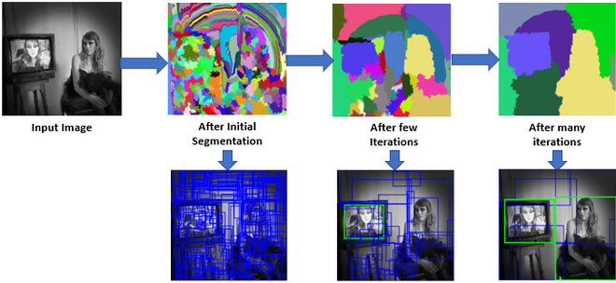
Selective Search
Initial Segmentation is done based on Graph based segmentation
Recursive combination of similar regions reduce the region proposals. When the proposals are around 2000, we can stop the algorithm.

Slide 11
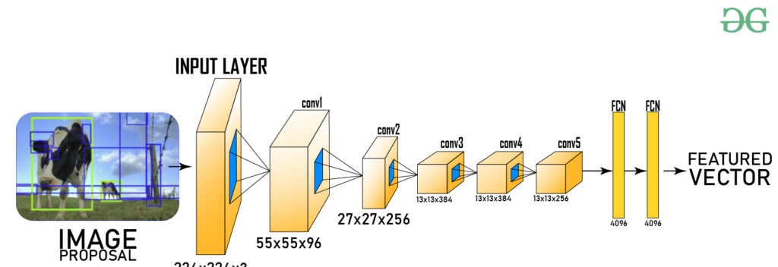
CNNs to R-CNNs
After generating Region Proposals, we send these to a CNN to get the feature vector.
The regions obtained as output will be of different sizes. These are warped into a unique size as required by the CNN architecture used.
This feature vector is passed on to SVM and BoundingBoxRegressor

Slide 12
R-CNN (Final Step)
SVM:
outputs the probability(confidence score) of presence of an object
Bounding Box Regressor:
Scale-invariant Linear Regression Model
Non-Maximum Suppression:
Used to Discard multiple boundaries around a single instance of object
Step I: Discard of objects with confidence score < threshold
Step II: Select a Region (say R) with high confidence score among the candidate regions around an object instance
Step III: Discard regions that intersection Over Union with the Region R

Slide 13
Disadvantages
Training of SVM needs the feature vector from CNN, so parallel working of CNN and SVM can’t take place
Selective Search has no learning steps – possibility of bad region proposals
Space to store feature maps
Not a real time method

Slide 14
R-CNN to Fast R-CNN
Instead of passing 2000 proposals into the CNN architecture, we pass directly the image to get feature map
Parallelly, this image is also passed onto Selective Search step to get Region proposals
These are then passed on to ROI pooling
ROI pooling:
Input: Feature map from convolution layer + Region Proposals from Selective Search
Output: Fixed size feature maps of region proposals as required by the next layer

Slide 15
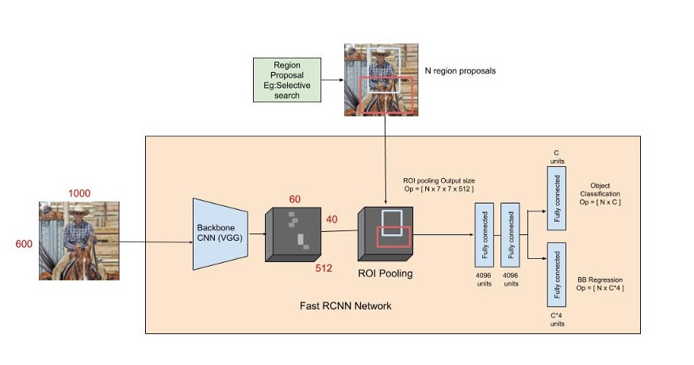
Fast R-CNN architecture

Slide 16
Faster R-CNN
Fast R-CNN require CPU. Major development of Faster R-CNN is replacing Selective Search with a neural network RPN (Region Proposal Network).
Network works on GPU
Region Proposal Network Working:
Image passed on to backbone CNN architecture to get a feature map
At each location in output map, place Anchors that denote possible location of objects
Check each anchor => refine them to give bounding box co-ordinates of region proposals

Slide 17
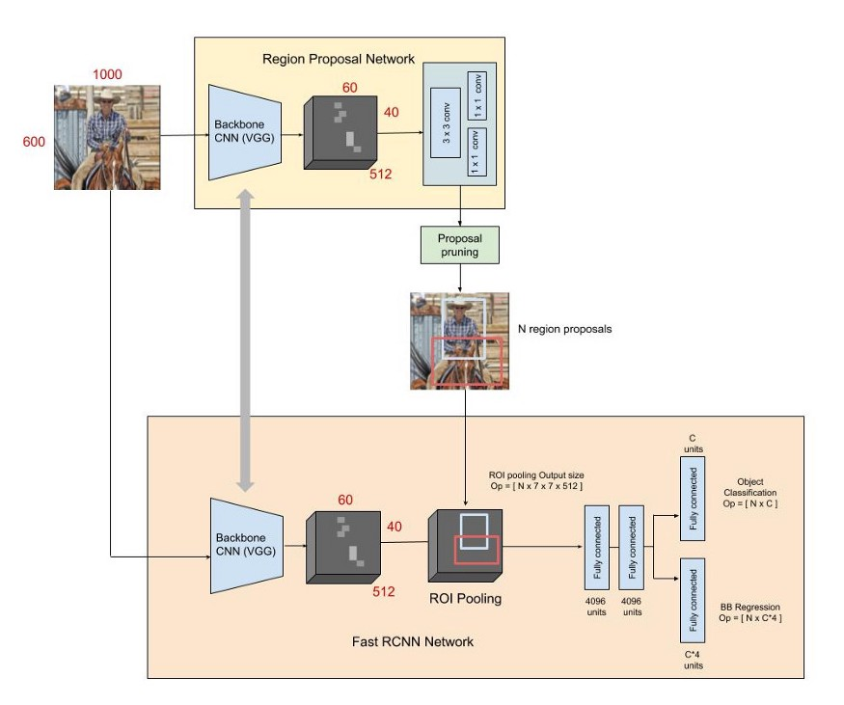
Faster R-CNN Architecture

Slide 18
Next Week..
Understanding the Dataset
YOLO architectures

Slide 19
THANK YOU

